Slide 1
Maze
Norina Akhtar
19643

Slide 2
Table of Contents
Problem Description
Introduction
How to design
Slide 6: Identify and Understand the problem
Slide 7: Investigation
Slide 8: Solution
Slide 9: Objective
Implementation
Slide 21: Python code
Slide 22: Test
Slide 23: Enhancement Ideas
Slide 24: Conclusion
Slide 25: References

Slide 3
Problem Description
Robot - Clear Route (Street, Highway)
The planner's problem is then to find a sequence of stances in L which take the robot from the start to the goal, such that the stances and the surfaces. It requires a clear path from start and can go as far as it can , and backtracks until it finds an unexplored path and then explore it step by step.
Self Driving Car- Unclear Route (Hotel, Hospital)
While the self driving car detects curbs and other vehicles when parking. Its like while rolling in an empty space until it detects any hurdle or curb. Self driving cars are looking for available space move in that direction until it achieve its desired path.

Slide 4
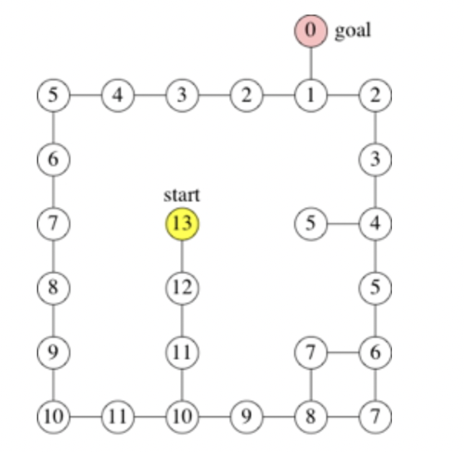
Introduction
Breadth First Approach has been used to get the shortest path for ball. Breadth First Search (BFS) algorithm traverses a graph in a breadthward motion and uses a queue to remember to get the next vertex to start a search, when a dead end occurs in any iteration.

Slide 5
How to design

Slide 6
Identify and Understand the problem
1:Walkable Path
0: Non-walkable Path
S:Starting point (start will be (0,0))
D:Destination
When you see problem first thing should come to your mind is what if starting point is not walkable(0) if it is not walkable then you should immediately return False or Not possible.
If the ball doesn't stop at destination because the ball is rolling through all cell, It means there is no possible way for ball.

Slide 7
Investigation
We'll solve our generated maze with two different methods:
Depth first search
Breadth first search
If you're not concerned about memory, you can pick either.
They have similar running time, but either may greatly outperform the other on any given problem simply due to the order in which the cells are visited.
However, if you're looking for the shortest path to some given cell in a general grid, use BFS , as that guarantees to find the shortest path

Slide 8
Solution
When a maze has multiple solutions, the solver may want to find the shortest path from start to finish. There are several algorithms to find shortest paths, most of them coming from graph theory. One such algorithm finds the shortest path by implementing a breadth first -search, while another, the A* Algorithm,uses a heuristic technique.

Slide 9
Objective
There is a ball in maze with empty spaces represented as 0 and wall(as 1). Our goal is to find the shortest path for ball through empty spaces by rolling up, down, left, or right, but it won't stop the rolling until hitting a wall . When the ball stops , it could choose the next direction.

Slide 10
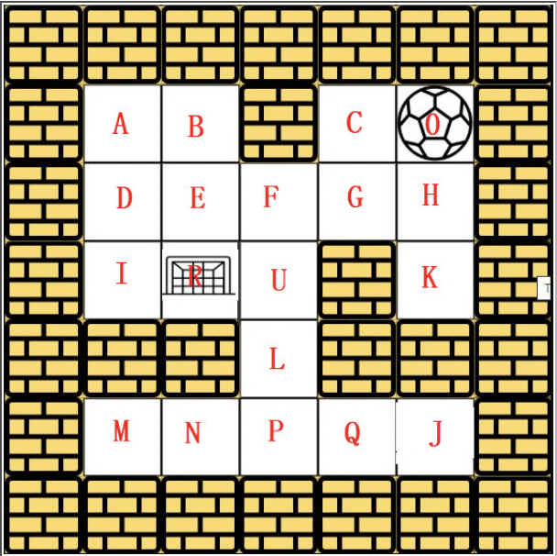
Implementation
Approach 5: Wheeled robots move in a Hotel: BFS
We will follow the same approach to solve this maze problem

Slide 11
Process
Visited : 0
0
Queue:
—----------------------------------------------
Visited : 0
1
Queue : 0
1.Add 0 to queue
2. Mark 0 as visited

Slide 12
Process
Visited : 0
1
Queue:
Remove 0 from Queue
Print 0
—----------------------------------------------
Visited : 0 C K
1 1 1
Queue : C K
1. Add C and K to queue
2. Mark C and K as visited

Slide 13
Process
Visited : 0 C K
1 1 1
Queue: K
Remove C from Queue
Print 0 C
—----------------------------------------------
Visited : 0 C K G
1 1 1 1
Queue : K G
1. Add G to queue
2. Mark G as visited

Slide 14
Process
Visited : 0 C K G
1 1 1 1
Queue: G
Remove K from Queue
Print 0 C K
—----------------------------------------------
Visited : 0 C K G
1 1 1 1
Queue :
1. Remove G from queue
2. Print 0 C K G

Slide 15
Process
Visited : 0 C K G D
1 1 1 1 1
Queue: D
Add D to the Queue
Mark D as visited
—----------------------------------------------
Visited : 0 C K G D
1 1 1 1 1
Queue :
1. Remove D from queue
2. Print 0 C K G D

Slide 16
Process
Visited : 0 C K G D A I
1 1 1 1 1 1 1
Queue: A I
Add A I to the Queue
Mark A I as visited
—----------------------------------------------
Visited : 0 C K G D A I
1 1 1 1 1 1 1
Queue : I
1. Remove A from queue
2. Print 0 C G D A

Slide 17
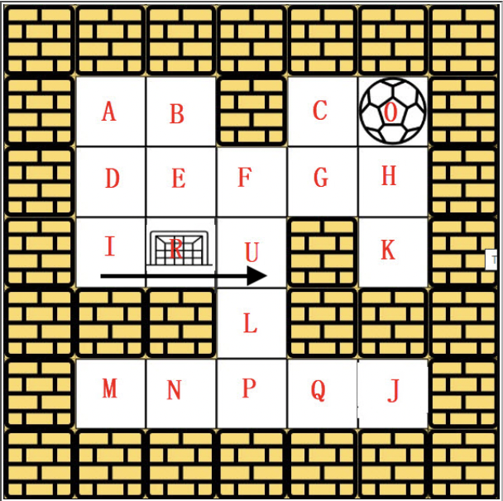
Process
Visited : 0 C K G D A I B
1 1 1 1 1 1 1 1
Queue: B
Remove I from the Queue
Print 0 C G D A I
—----------------------------------------------
Visited : 0 C K G D A I B U
1 1 1 1 1 1 1 1 1
Queue : B U
1. Add U to Queue
2. Mark U as Visited

Slide 18
Process
Visited : 0 C K G D A I B U
1 1 1 1 1 1 1 1 1
Queue : U
1. Add B from the Queue
2. Print 0 C K G A I B

Slide 19
Result
The ball can go through the empty spaces by rolling up, down, left, right, but it won't stop rolling until hitting a wall. When the ball stops, it could choose the next direction.
In the above case we can't find the possible solution because the ball won't stop at R which is destination. The ball roll up and stop at U because it hit wall. Hence, we possible shortest path is not possible using this approach.
There is no way for ball to stop at the destination in this case.

Slide 20
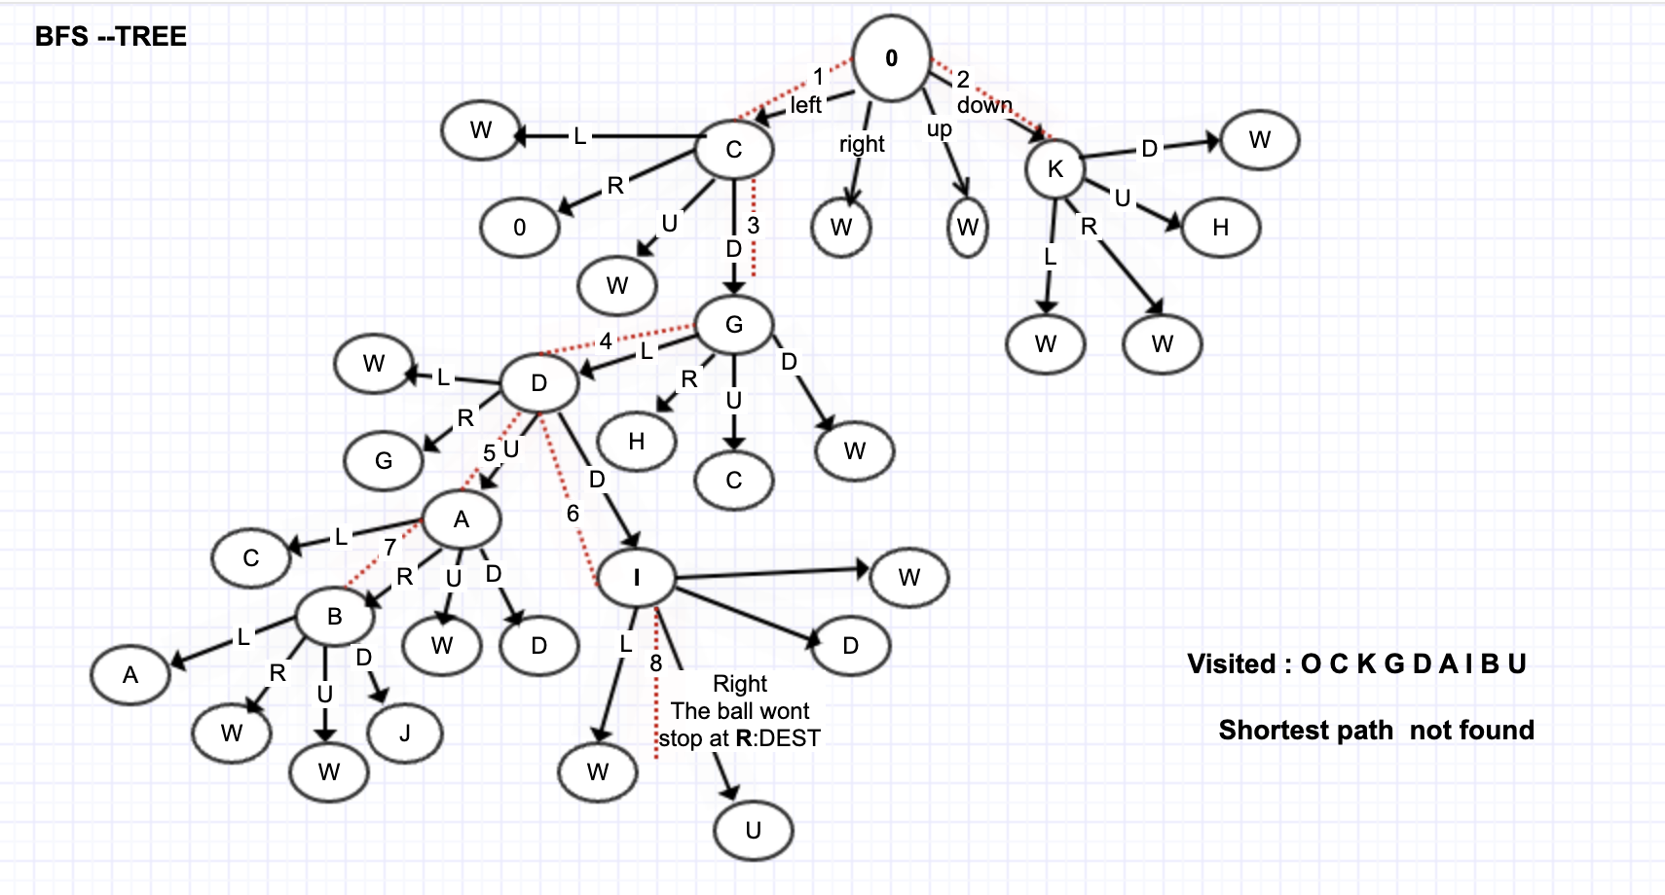

Slide 21
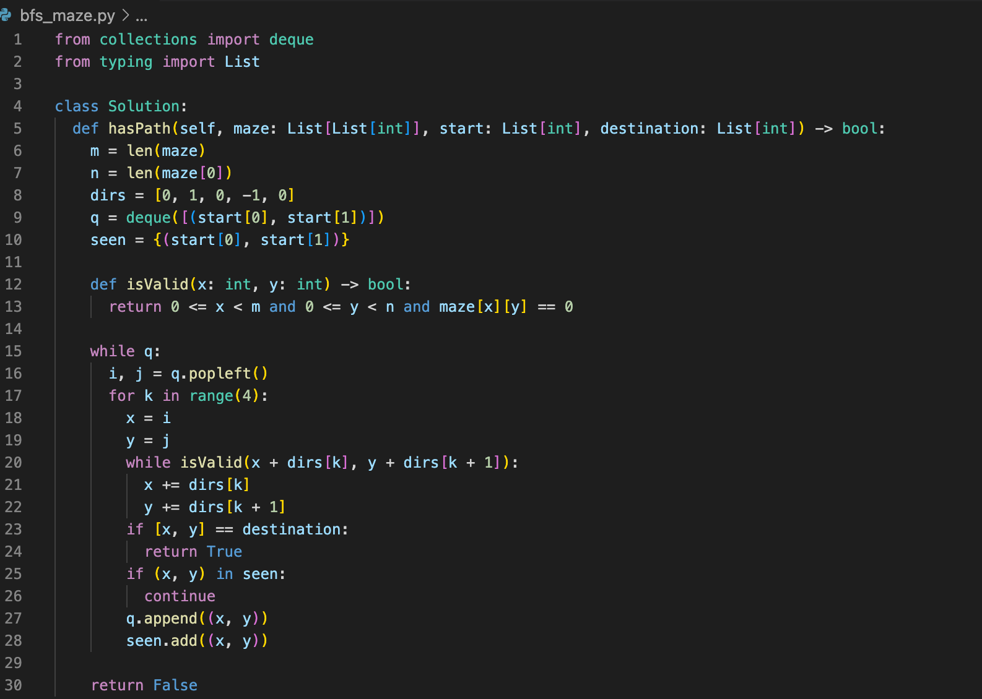
Python code

Slide 22
Test

Slide 23
Enhancement Ideas
The problem can be solved by using using different approaches i-e Dijkstra's algorithm, Bellman Ford’s algorithm, breadth first approach and Depth first approach etc.
However, shortest path is required thats why BFS has been considered to solve this problem.

Slide 24
Conclusion
Time complexity : O(mn). Complete traversal of maze will be done in the worst case. Here, m and n refers to the number of rows and coloumns of the maze.
Space complexity : O(mn). visited array of size mn is used and queue size can grow upto mn in worst case.
The breadth-first search algorithm uses a queue to visit cells in increasing distance order from the start until the finish is reached. Each visited cell needs to keep track of its distance from the start or which adjacent cell nearer to the start caused it to be added to the queue. Hence, in the given example we are unable to find the shortest path.

Slide 25
References
Find the shortest path in a maze
Shortest path in a maze – Lee Algorithm
Problem F: The Maze Makers
Backtracking or BFS

